Slide 1
IT SOFTWARE, DATA, AND CONTINGENCY PLANNING

Slide 2
SOFTWARE
Programs executed by the hardware.
Written in programing language
  System software
    OS
    Utility
  Applications

Slide 3
SOFTWARE
Programing Languages.
First generation
  Binary
Second Generation
  Assembly languages—largely superseded by;
Third Generation
  COBOL, FORTRAN, BASIC, C, C++, Java
Fourth Generation
  Generalized Audit Software (GAS), Computer Assisted Audit Techniques, HTML, XML, XBRL

Slide 4
STORAGE
Bits & Bytes, Fields & Records
  1s & 0s

Slide 5
File Organization
Flat files
  Spread sheets
  Sequential tape mounted
Databases
  Hierarchical—parent, child,…
  Relational—tables linked by key fields (attributes).
    System of cardinality
      How unique
        i.e. Customer ID has high cardinality—one # for each customer
      Referential Integrity
        Record entered in one table must have an attribute that appears in another table.

Slide 6
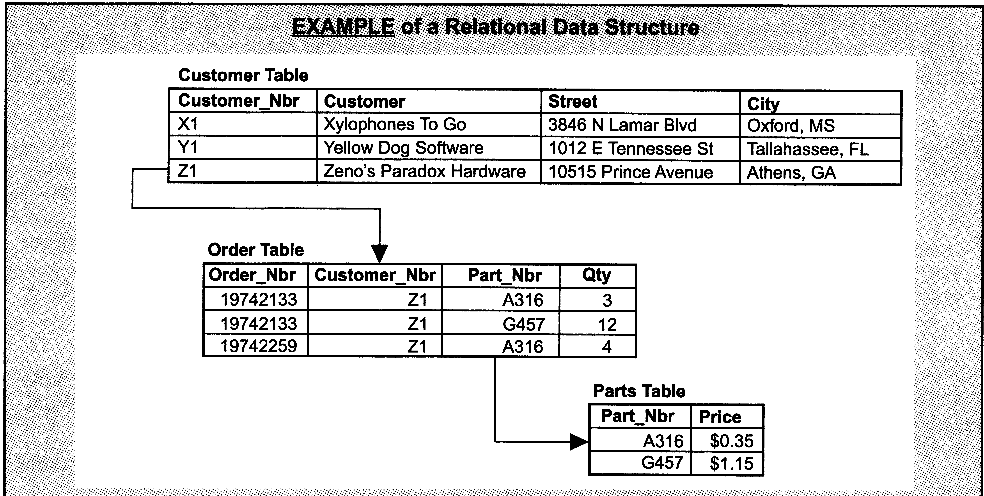

Slide 7
File Organization
      Object oriented DB
        Great for graphic and multimedia objects, but not good for accounting data.

Slide 8
Database Management Systems
  Software that enforces DB rules and requirements.
  Use SQL as:
    Data definition language
    Data manipulation language

Slide 9
Application Development & Maintenance
  Needs assessment
      Current system adequate?
      If not, which needs aren’t met.
      Can current system be modified?
      Plan for future
  Examine business processes
      Redesign if required

Slide 10
Application Development & Maintenance
  Business process design should be a bottom up process.
  Next—Build or Buy?
      Cost-benefit
        Can we buy a system that matches our business processes, or;
        Modify processes to fit system
        Modify system to fit existing processes

Slide 11
Application Development & Maintenance
  Business process design should be a bottom up process.
  Next—Build or Buy?
      Cost-benefit
        Build system in house that matches processes
      No inexpensive choices here!

Slide 12
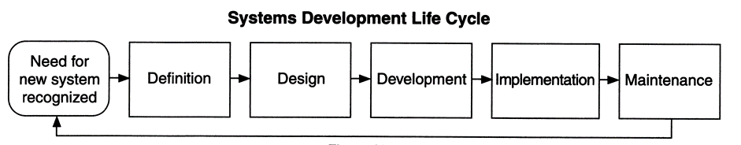
Application Development & Maintenance
  DEV, QUA, PROD
    Systems Development Lifecycle
Q&A

Slide 13
Contingency Planning
Business Continuity—problem
  Plan to continue operations when the IS is down.
Disaster Recovery—big problem
  Plan to recover from a major disaster and resume or continue operations.

Slide 14
Contingency Planning
Cloud computing could help firms with disaster recovery.
  DRaaS
  Data, software, platform reside on the vendor’s server farms.
  When contracting with vendors, pay close attention to the contract service agreement (CSO) terms.
    What if a disaster takes out one of the farms?
Backup Plans
  Backup data and software and store offsite.
  How often?
    Depends on transaction volume.
      How many day’s, hours, minutes of transactions can you afford to lose?

Slide 15
Contingency Planning
Cost-Benefit Analysis
  Cost of backups and redundant systems vs
  Value of lost data and sales.
  i.e. cost of backup power supply vs cost of lost sales/minute.
    Fault tolerant systems—redundant array of independent drives (RAID)
  Recovery Time Objective (RTO)--target time set for the recovery of IT and business activities after a disaster has struck
  Recovery Point Objective (RPO)--time between data backups and the amount of data that could be lost in between backups. How much data can you afford to lose?

Slide 16
Contingency Planning
Disaster Recovery Plan
  Based on risk analysis.
    What are the threats?
      Natural disasters
      Human disasters
      Which operations are mission critical?
        Will people die?
    What preventative and detective controls are in place?
      Cloud
      Redundant sites
      Redundant personnel

Slide 17
Contingency Planning
Disaster Recovery Plan
  People
    Communication
      Cell and internet service may not function.
      Have a plan
        Location to meet and regroup
        Backup meeting location
        Plan for replacing personnel and performing duties
  Hardware
    Contract with a vendor for a backup site from which to continue operations.
    Hot site
    Warm site
    Cold site

Slide 18
Contingency Planning
Disaster Recovery Plan
  Software and Data
    Backup in a secure location
    Cloud helps with this, but we are still transitioning.
  Public Cloud vs Private Cloud
    Public—very careful with vendor contract.
    Private—much more complicated.

